Slide 1
Fake News Classification
Mark Gameng
Notes:
Hello, My name is Mark and I will be taking about how I did my project.

Slide 2
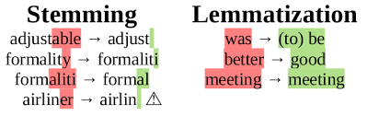
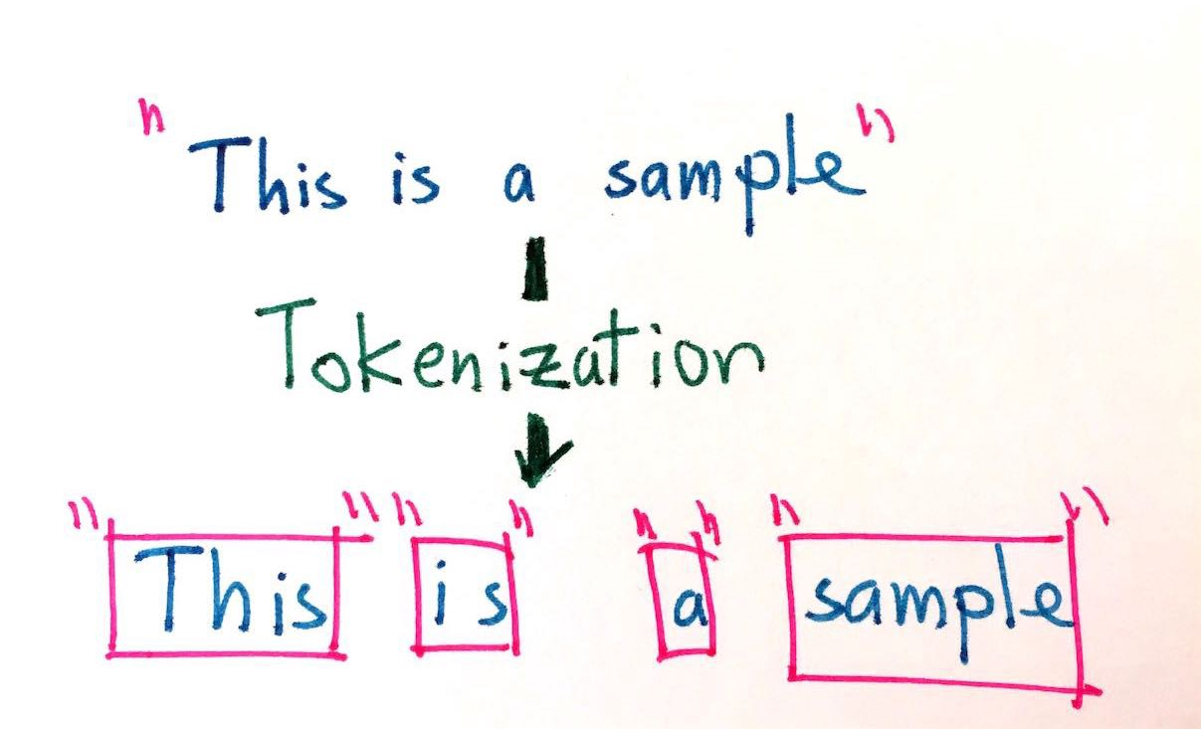
Pre-processing
Removed capitalization
Removed Punctuations
Removed Special Characters
Cleaned up titles
Remove extra spaces
Tokenize (nltk.tokenize)
Lemmatize (nltk.stem)
Notes:
For pre-processing, I did the usual. I removed capitalization, punctuations and special characters. I also cleaned up the titles a bit more such as removing extra spaces and such. Then I word tokenized and lemmatized using nltk.

Slide 3
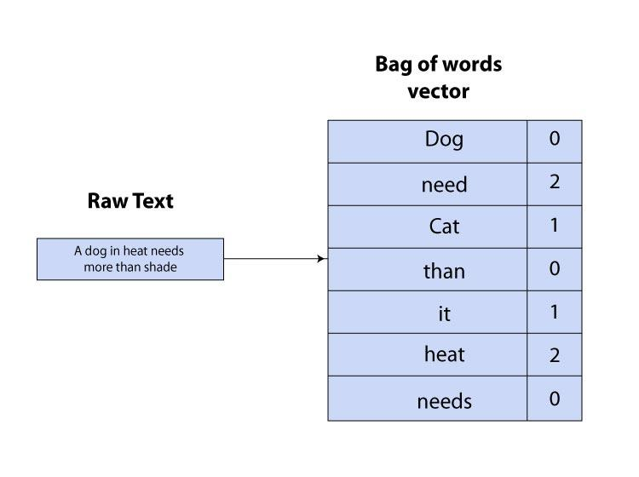
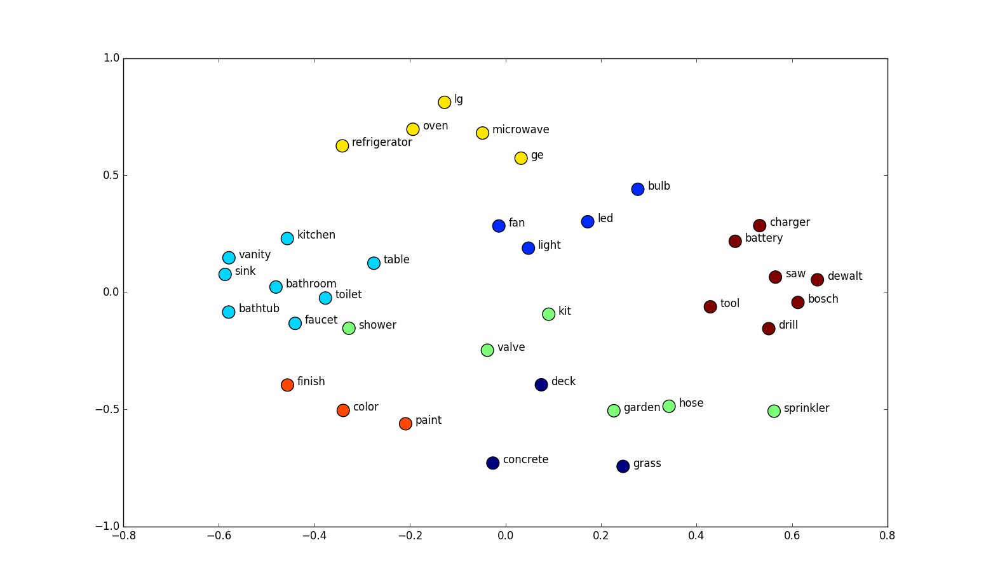
Features
Bag of words (sklearn)
basic
Tf-idf (sklearn)
Better than bag of words
Similarity of sentences
Cosine similarity (sklearn)
N-grams
TfidfVectorizer(... ngram_range = (2,4)
Word sequences most correlated with each label using chi2
Notes:
So for the features, I thought about doing bag of words, tf-idf, and then similarity between sentences and n-grams. The similarity of sentences are useful for determining whether the titles or related or not.. For n-grams, I used 2 grams to 4 grams and found the word sequences that is most correlated with each label using chi2.

Slide 4
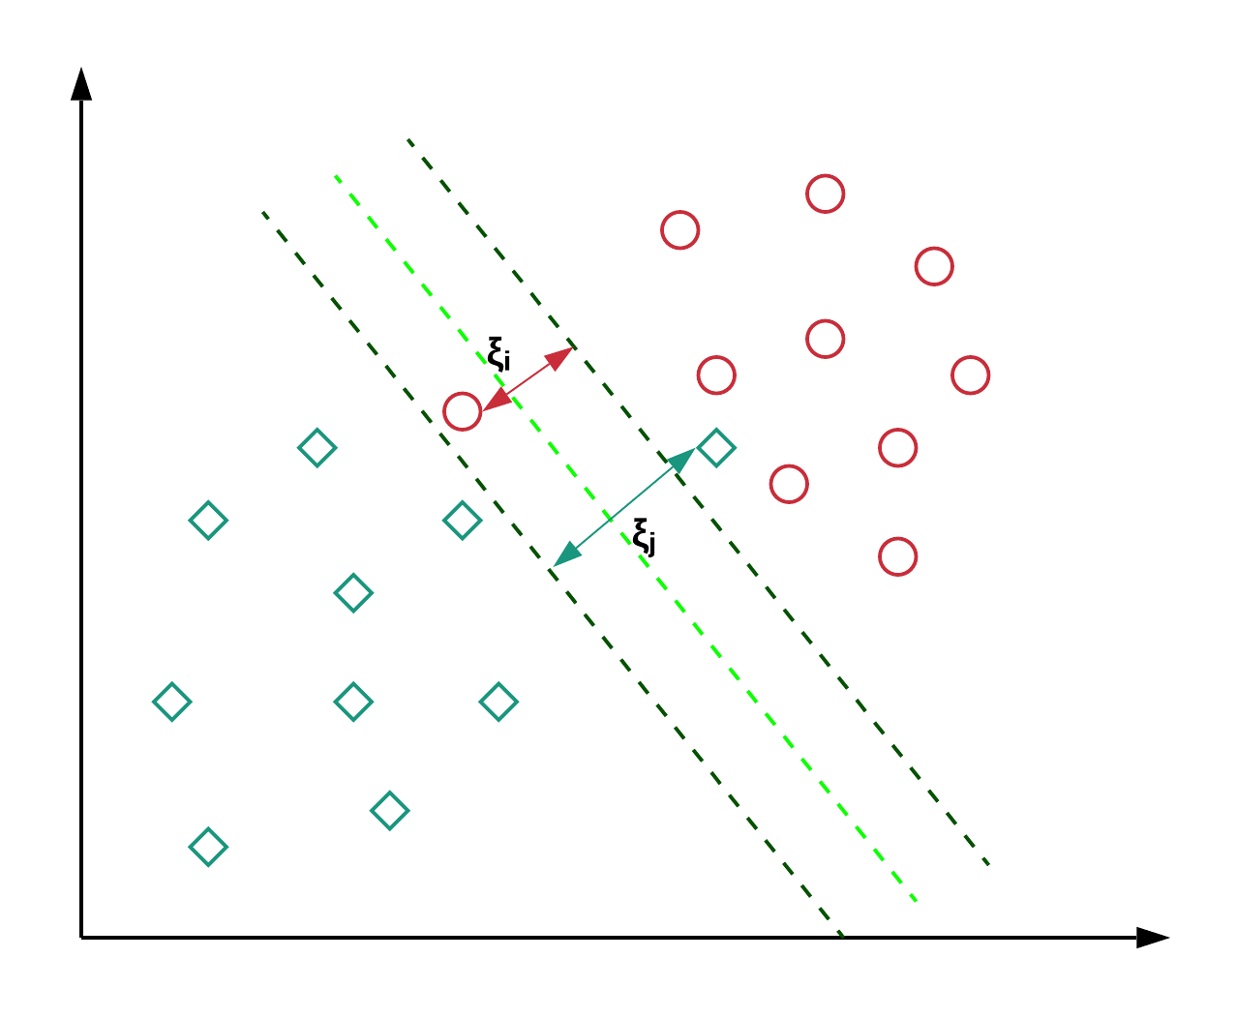
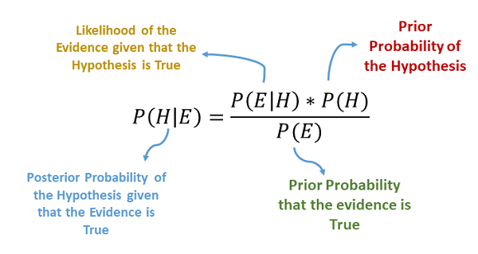
Models
Multinomial Naive Bayes (sklearn)
Logistic Regression (sklearn)
Linear Support Vector Classification (sklearn)
Notes:
So for models, I decided to use Multinomial Naive Bayes, Logistic Regression and Linear Support Vector Classification. I used the sklearn library for all of these.

Slide 5
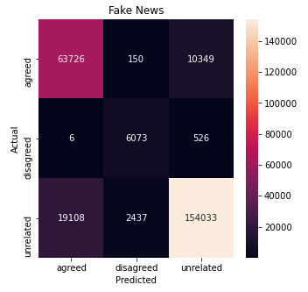
Results
Linear SVC
Model | Testing Accuracy | F1 Score
Multinomial Naive Bayes | 0.76 | 0.74
Linear SVC | 0.79 | 0.80
Logistic Regression | 0.74 | 0.75
Notes:
For the training dataset, I had 30% be used for evaluation and these were the results. The best result I got was 80% testing accuracy from the Linear SVC. Then for the submission, I used SVC and trained it all on the training dataset and got a training accuracy of 87%.

Slide 6
Thanks
Notes:
Thats it, Thank you.

